Slide 1
05/1~2/2021
new10_contra/contra_usa_v2_l1/l2/l3/t1, contra_usa_wd0
new10_contra/vanilla_fusion/baseline_usa_v3_run2, baseline_usa_wd0
05/3~4/2021
new10_contra/contra_usa_v2_l4,t2,run2
new10_contra/pretrain/src_usa_pretrain_v0, finetune_v0
05/3~4/2021
new10_contra/pretrain/src_usa_finetune_v1
multi-stage contrastive
convergence speed
finetune with fewer labels

Slide 2
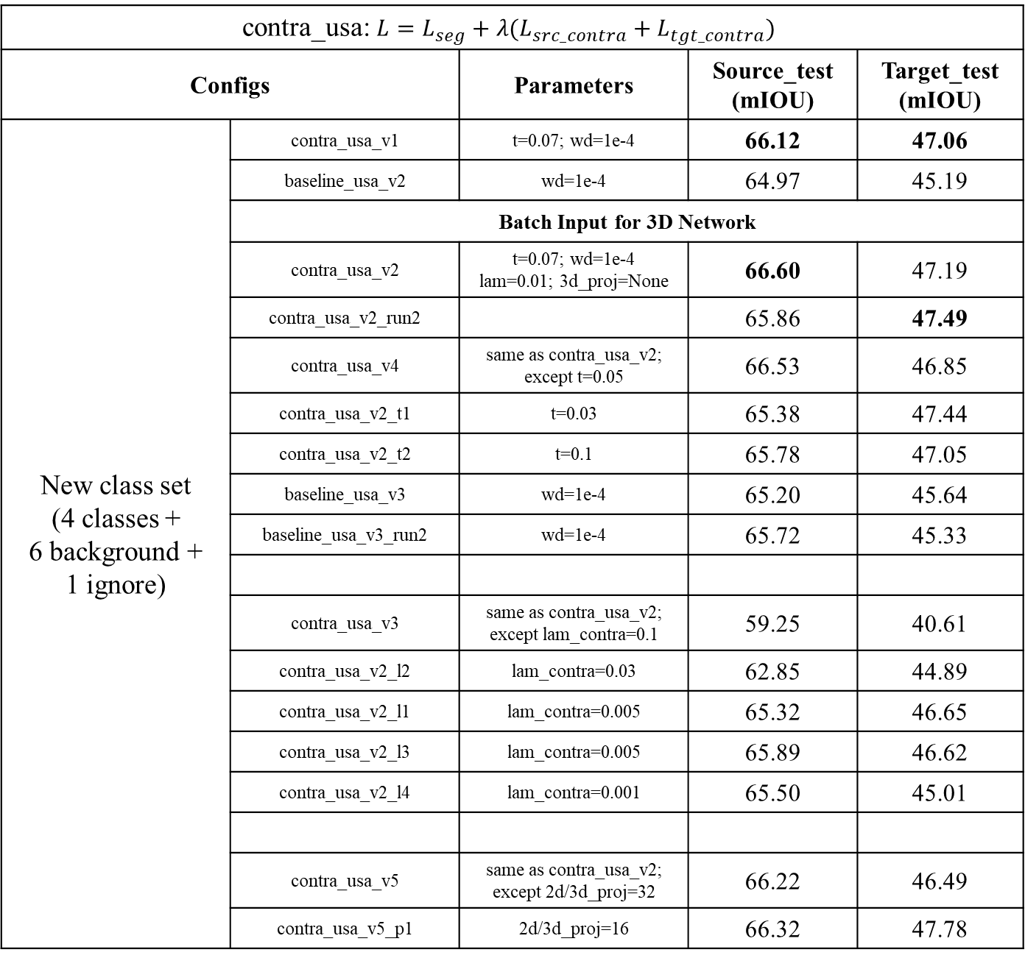
contra_usa: $L=L_{seg}+λ(L_{src_contra}+L_{tgt_contra})$
Configs | Configs | Parameters | Source_test (mIOU) | Target_test (mIOU)
New class set (4 classes + 6 background + 1 ignore) | contra_usa_v1 | t=0.07; wd=1e-4 | 66.12 | 47.06
 | baseline_usa_v2 | wd=1e-4 | 64.97 | 45.19
 | Batch Input for 3D Network
 | contra_usa_v2 | t=0.07; wd=1e-4 lam=0.01; 3d_proj=None | 66.60 | 47.19
 | contra_usa_v2_run2 |  | 65.86 | 47.49
 | contra_usa_v4 | same as contra_usa_v2; except t=0.05 | 66.53 | 46.85
 | contra_usa_v2_t1 | t=0.03 | 65.38 | 47.44
 | contra_usa_v2_t2 | t=0.1 | 65.78 | 47.05
 | baseline_usa_v3 | wd=1e-4 | 65.20 | 45.64
 | baseline_usa_v3_run2 | wd=1e-4 | 65.72 | 45.33
 | contra_usa_v3 | same as contra_usa_v2; except lam_contra=0.1 | 59.25 | 40.61
 | contra_usa_v2_l2 | lam_contra=0.03 | 62.85 | 44.89
 | contra_usa_v2_l1 | lam_contra=0.005 | 65.32 | 46.65
 | contra_usa_v2_l3 | lam_contra=0.005 | 65.89 | 46.62
 | contra_usa_v2_l4 | lam_contra=0.001 | 65.50 | 45.01
 | contra_usa_v5 | same as contra_usa_v2; except 2d/3d_proj=32 | 66.22 | 46.49
 | contra_usa_v5_p1 | 2d/3d_proj=16 | 66.32 | 47.78
PointContrast 3d aug

Slide 3
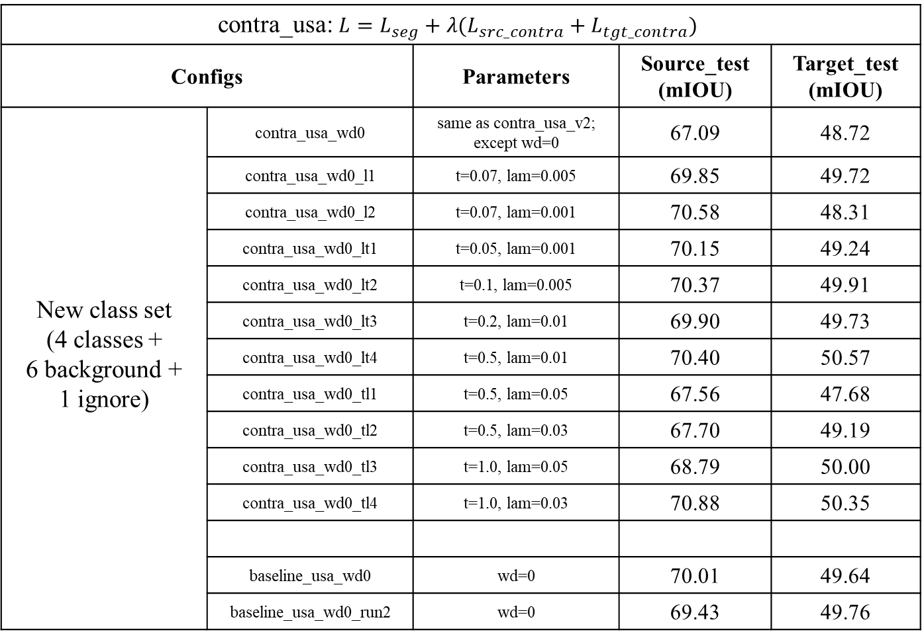
contra_usa: $L=L_{seg}+λ(L_{src_contra}+L_{tgt_contra})$
Configs | Configs | Parameters | Source_test (mIOU) | Target_test (mIOU)
New class set (4 classes + 6 background + 1 ignore) | contra_usa_wd0 | same as contra_usa_v2; except wd=0 | 67.09 | 48.72
 | contra_usa_wd0_l1 | t=0.07, lam=0.005 | 69.85 | 49.72
 | contra_usa_wd0_l2 | t=0.07, lam=0.001 | 70.58 | 48.31
 | contra_usa_wd0_lt1 | t=0.05, lam=0.001 | 70.15 | 49.24
 | contra_usa_wd0_lt2 | t=0.1, lam=0.005 | 70.37 | 49.91
 | contra_usa_wd0_lt3 | t=0.2, lam=0.01 | 69.90 | 49.73
 | contra_usa_wd0_lt4 | t=0.5, lam=0.01 | 70.40 | 50.57
 | contra_usa_wd0_tl1 | t=0.5, lam=0.05 | 67.56 | 47.68
 | contra_usa_wd0_tl2 | t=0.5, lam=0.03 | 67.70 | 49.19
 | contra_usa_wd0_tl3 | t=1.0, lam=0.05 | 68.79 | 50.00
 | contra_usa_wd0_tl4 | t=1.0, lam=0.03 | 70.88 | 50.35
 | baseline_usa_wd0 | wd=0 | 70.01 | 49.64
 | baseline_usa_wd0_run2 | wd=0 | 69.43 | 49.76

Slide 4
Single2D3DV2
Configs | Parameters | Source_test (mIOU) | Target_test (mIOU)
single_2d_usa_v0 | wd=1e-4 | 62.38 | 39.52
single_2d_usa_v1 | wd=0 | 67.22 | 42.05
single_2d_usa_v2 | wd=1e-2 | 45.65 | 29.12
single_3d_usa_scn2 | wd=0 | 58.14 | 44.20
single_3d_usa_scn1 | wd=0 (Single2D3D) | 39.84 | 31.13
single_3d_usa_scn0 | wd=1e-4 | 55.47 | 42.22

Slide 5
Pre-train Fine-tune | contrastive loss ablation study on single source domain
Configs | Configs | Parameters | Source_test (mIOU) | Target_test (mIOU)
New class set (4 classes + 6 background + 1 ignore) | src & tgt contrast
 | contra_usa_pretrain_v2 | lam_contra=1.0, t=0.07, wd=1e-4, 3d_proj=None
 | usa_finetune_v2 | wd=1e-4 | 65.59 | 45.55
New class set (4 classes + 6 background + 1 ignore) | src contrast
 | src_usa_pretrain_v0 | lam_contra=1.0, t=0.07, wd=1e-4, 3d_proj=None
 | src_usa_finetune_v0 | wd=1e-4 | 66.25 | (45.61)
 | src_usa_finetune_v0_w1 | wd=0 | 70.57 | (49.39)
 | src_usa_pretrain_v1 | same as pretrain_v0 except wd=0
 | src_usa_finetune_v1 | wd=0 | 69.94 | (49.68)
 | src_usa_pretrain_v2 | same as pretrain_v0 except 2d/3d_proj=16
 | src_usa_finetune_v2 | wd=0 | 69.85 | (50.61)
 | Baseline(src supervised loss)
 | baseline_usa | wd=1e-4 | 65.72 | (45.33)
 | baseline_usa | wd=0 | 70.01 | (49.64)

Slide 6
04/22/2021 meet
draw backbone structure
multiple images and contraints inbetween
add contraints(contrast) at different resolutions
learn the correspondence(predict point position on heatmap)
Dense Contrastive Learning for Self-Supervised Visual Pre-Training
04/23~24/2021
UNetSCNManual code; UNetSCN, UNetResNet34 structure
04/25~27/2021
new10_contra/vanilla_fusion/single_3d_* (single_2d_3d_v2.py test code bug)
new10_contra/vanilla_fusion/baseline_v3
new10_contra/contra_usa_v2
04/28/2021
new10_contra/contra_usa_pretrain_v2, usa_finetune_v2
new10_contra/contra_usa_v3, contra_usa_v4

Slide 7
04/10~13/2021
xMuda class set / new class set pre-train & fine-tune
04/15/2021
new10_contra/contra_usa_v0
new10_contra/usa_finetune_v1
04/17~21/2021
new10_contra/contra_usa_v1
new10_contra/usa_finetune_v0_w1/w2
more epochs
contrast head; temperature (0.01 0.1 1 10 100)
fusion at different stage
3D backbone

Slide 8
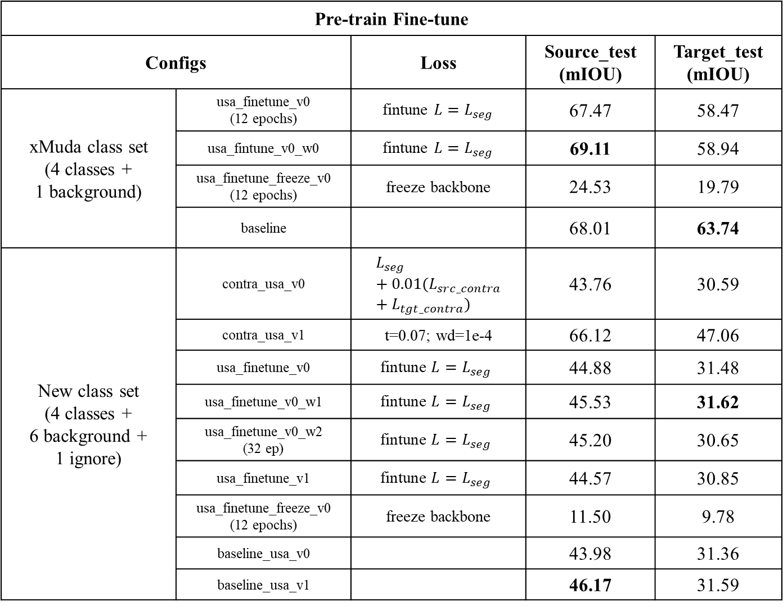
Pre-train Fine-tune | contrastive loss ablation study on single source domain
Configs | Configs | Loss | Source_test (mIOU) | Target_test (mIOU)
xMuda class set (4 classes + 1 background) | usa_finetune_v0 (12 epochs) | fintune $L=L_{seg}$ | 67.47 | 58.47
 | usa_fintune_v0_w0 | fintune $L=L_{seg}$ | 69.11 | 58.94
 | usa_finetune_freeze_v0 (12 epochs) | freeze backbone | 24.53 | 19.79
 | baseline |  | 68.01 | 63.74
New class set (4 classes + 6 background + 1 ignore) | contra_usa_v0 | $$L_{seg}+0.01(L_{src_contra}+L_{tgt_contra})$$ | 43.76 | 30.59
 | contra_usa_v1 | t=0.07; wd=1e-4 | 66.12 | 47.06
New class set (4 classes + 6 background + 1 ignore) | usa_finetune_v0 | $$\text{fintune} L=L_{seg}$$ | 44.88 | 31.48
 | usa_finetune_v0_w1 | $$\text{fintune} L=L_{seg}$$ | 45.53 | 31.62
 | usa_finetune_v0_w2 (32 ep) | $$\text{fintune} L=L_{seg}$$ | 45.20 | 30.65
 | usa_finetune_v1 | $$\text{fintune} L=L_{seg}$$ | 44.57 | 30.85
 | usa_finetune_freeze_v0 (12 epochs) | freeze backbone | 11.50 | 9.78
 | baseline_usa_v0 |  | 43.98 | 31.36
 | baseline_usa_v1 |  | 46.17 | 31.59

Slide 9
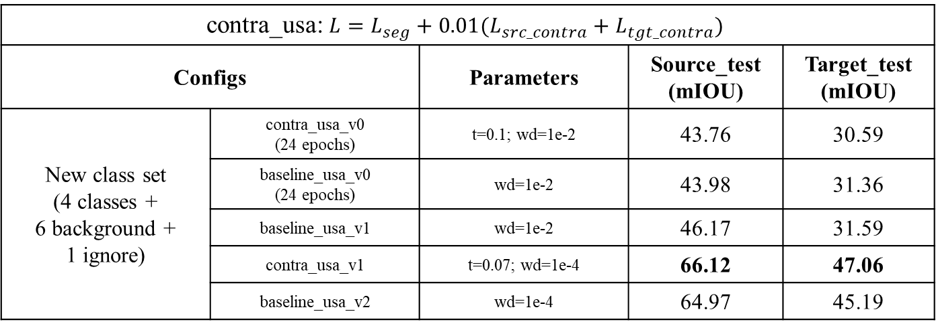
contra_usa: $L=L_{seg}+0.01(L_{src_contra}+L_{tgt_contra})$
Configs | Configs | Parameters | Source_test (mIOU) | Target_test (mIOU)
New class set (4 classes + 6 background + 1 ignore) | contra_usa_v0 (24 epochs) | t=0.1; wd=1e-2 | 43.76 | 30.59
 | baseline_usa_v0 (24 epochs) | wd=1e-2 | 43.98 | 31.36
 | baseline_usa_v1 | wd=1e-2 | 46.17 | 31.59
 | contra_usa_v1 | t=0.07; wd=1e-4 | 66.12 | 47.06
 | baseline_usa_v2 | wd=1e-4 | 64.97 | 45.19

Slide 10
new class set(11 classes)
Batch Input for 3D Network
SegFusionV4; Single2D3DV2
weight_decay(1e-2, 1e-4) & batch input(Single2D3D, Single2D3DV2) have a great effect on UNetSCN

Slide 13
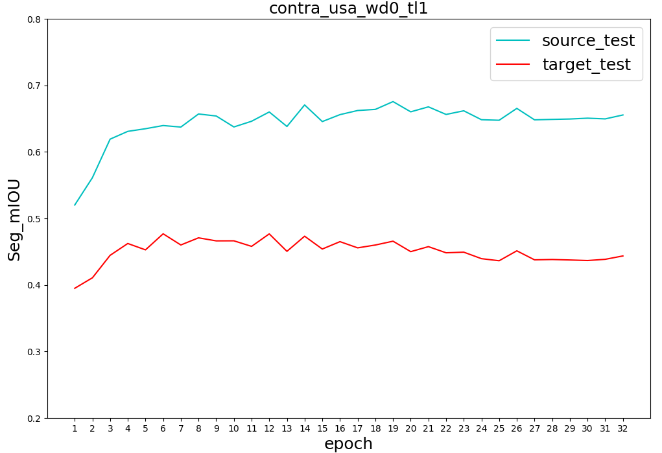
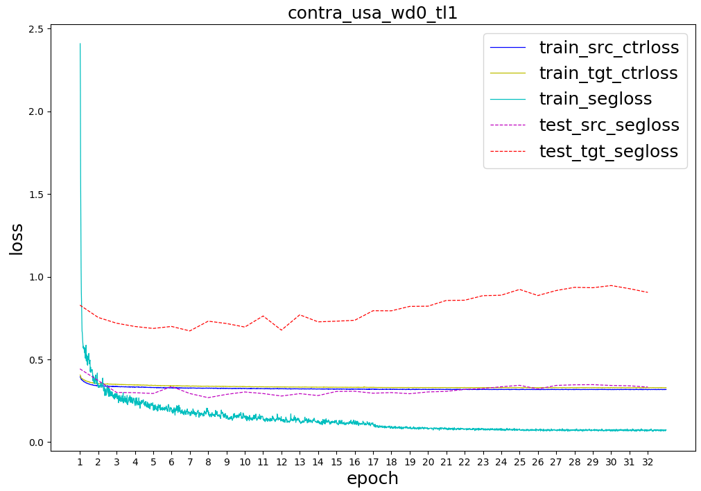
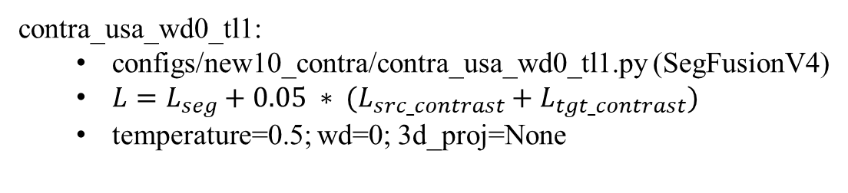
contra_usa_wd0_tl1:
configs/new10_contra/contra_usa_wd0_tl1.py (SegFusionV4)
$L=L_{seg}+0.05 ∗ (L_{src_contrast}+L_{tgt_contrast})$
temperature=0.5; wd=0; 3d_proj=None

Slide 14
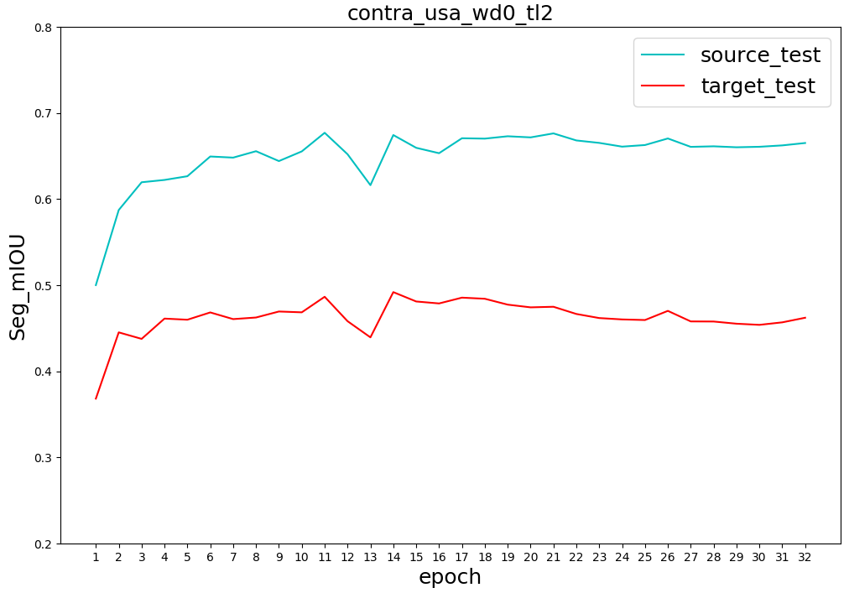
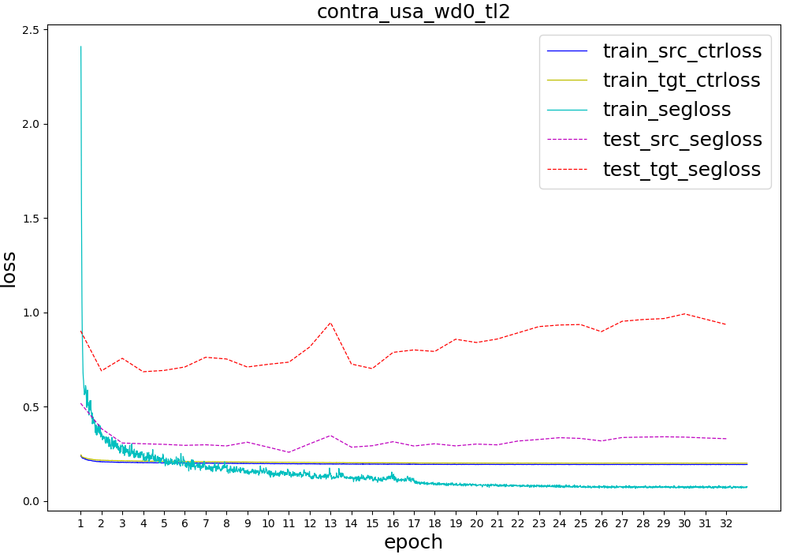
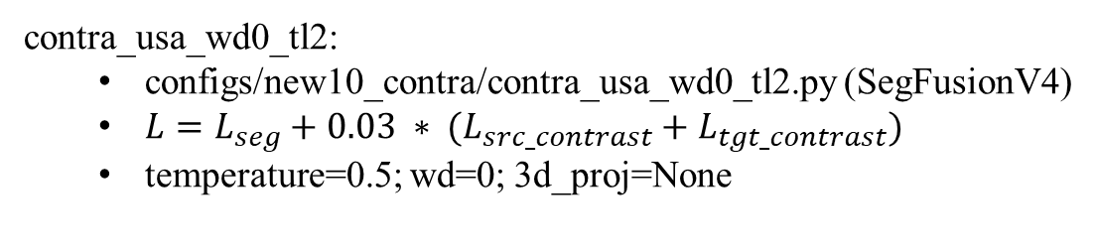
contra_usa_wd0_tl2:
configs/new10_contra/contra_usa_wd0_tl2.py (SegFusionV4)
$L=L_{seg}+0.03 ∗ (L_{src_contrast}+L_{tgt_contrast})$
temperature=0.5; wd=0; 3d_proj=None

Slide 15
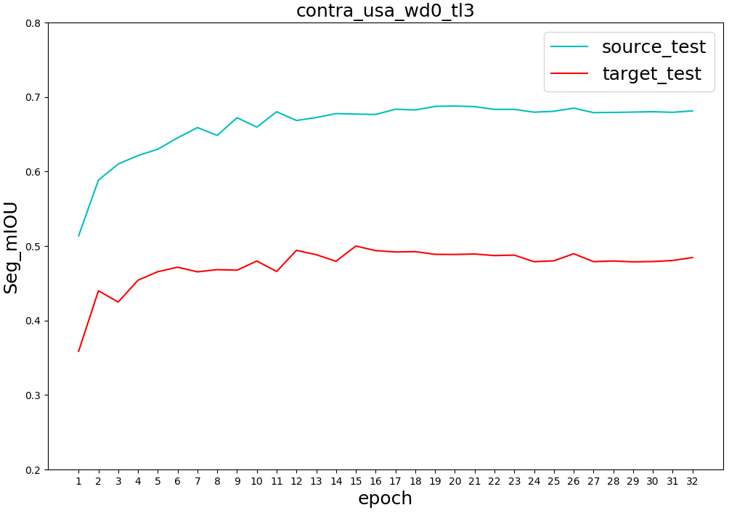
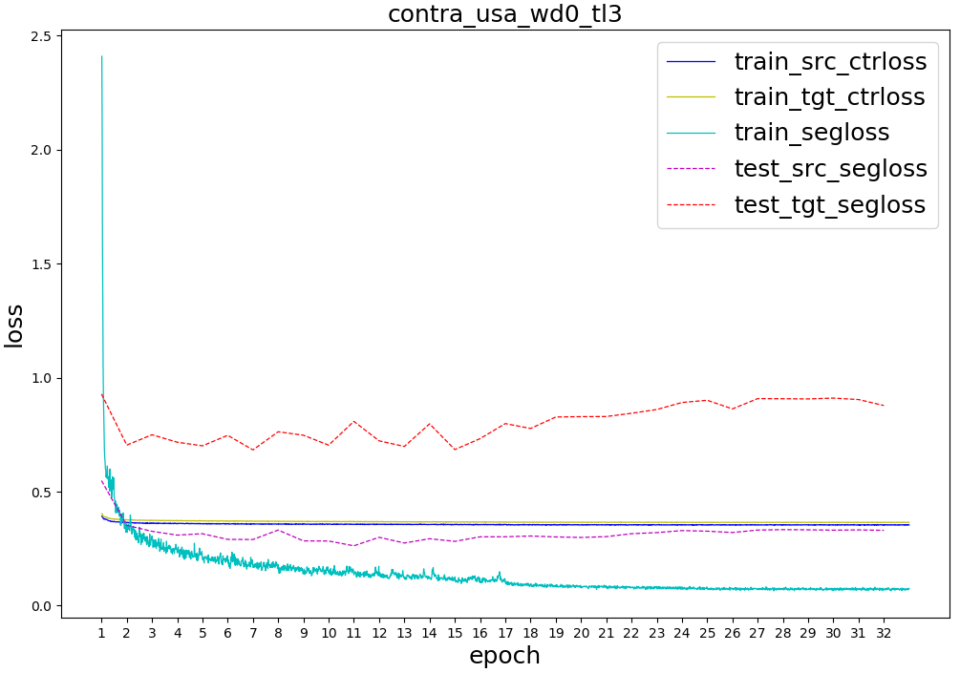
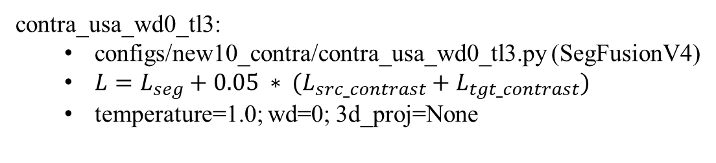
contra_usa_wd0_tl3:
configs/new10_contra/contra_usa_wd0_tl3.py (SegFusionV4)
$L=L_{seg}+0.05 ∗ (L_{src_contrast}+L_{tgt_contrast})$
temperature=1.0; wd=0; 3d_proj=None

Slide 16
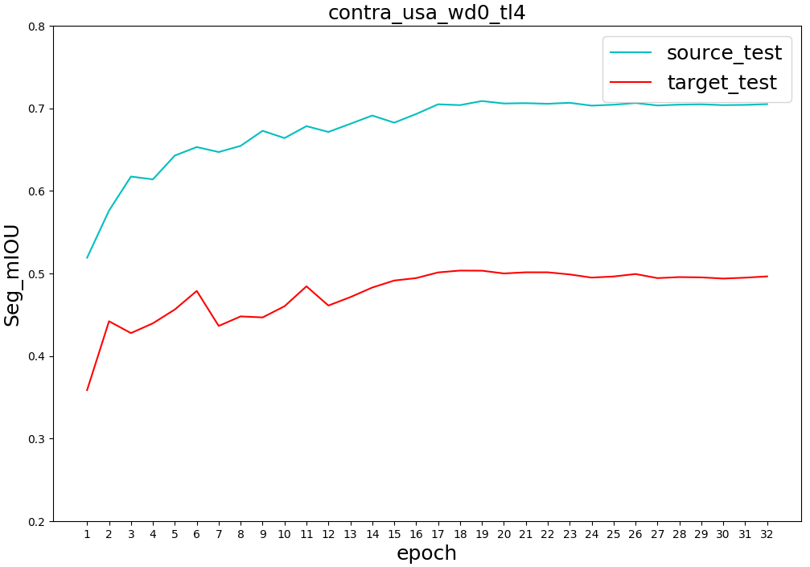
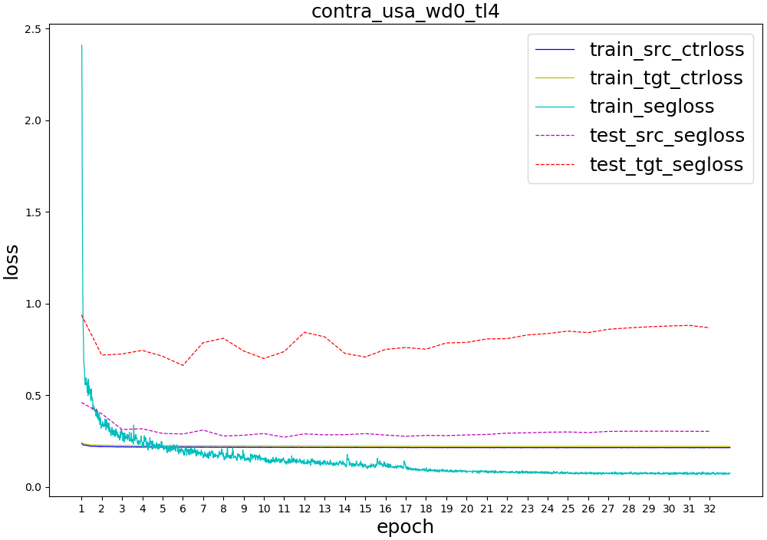
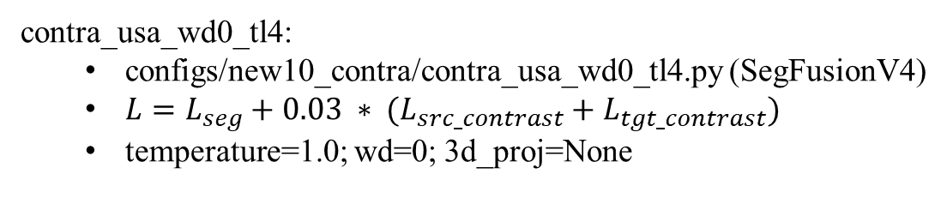
contra_usa_wd0_tl4:
configs/new10_contra/contra_usa_wd0_tl4.py (SegFusionV4)
$L=L_{seg}+0.03 ∗ (L_{src_contrast}+L_{tgt_contrast})$
temperature=1.0; wd=0; 3d_proj=None

Slide 17
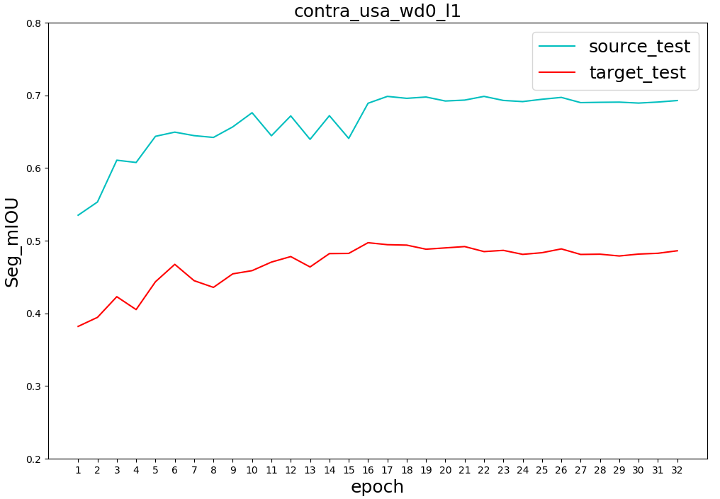
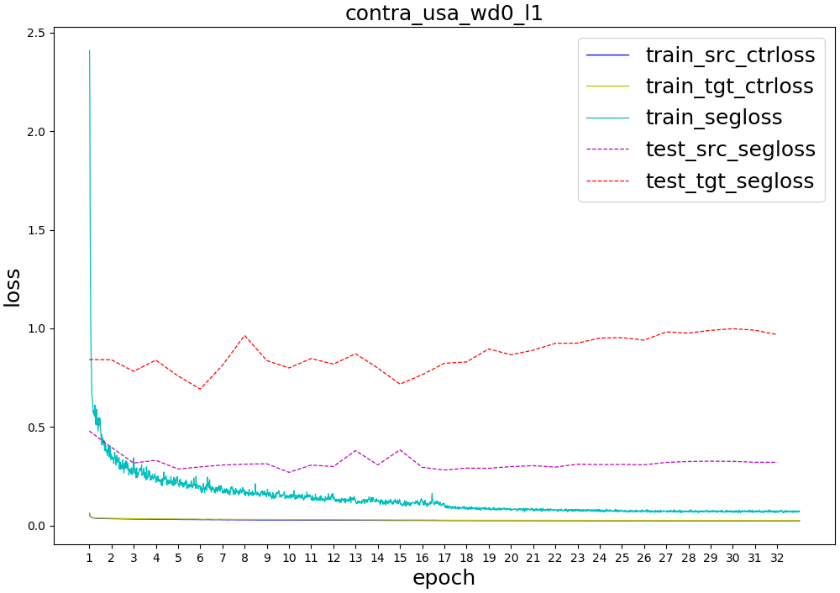
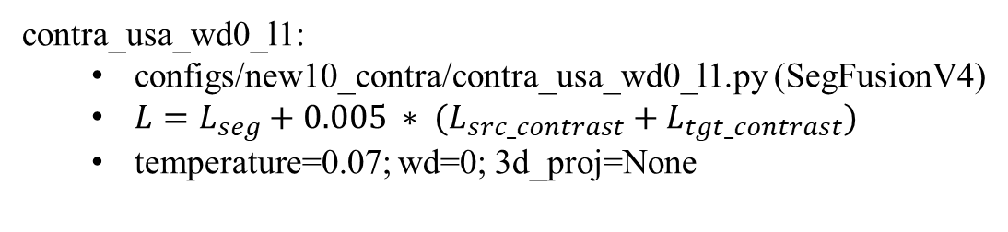
contra_usa_wd0_l1:
configs/new10_contra/contra_usa_wd0_l1.py (SegFusionV4)
$L=L_{seg}+0.005 ∗ (L_{src_contrast}+L_{tgt_contrast})$
temperature=0.07; wd=0; 3d_proj=None

Slide 18
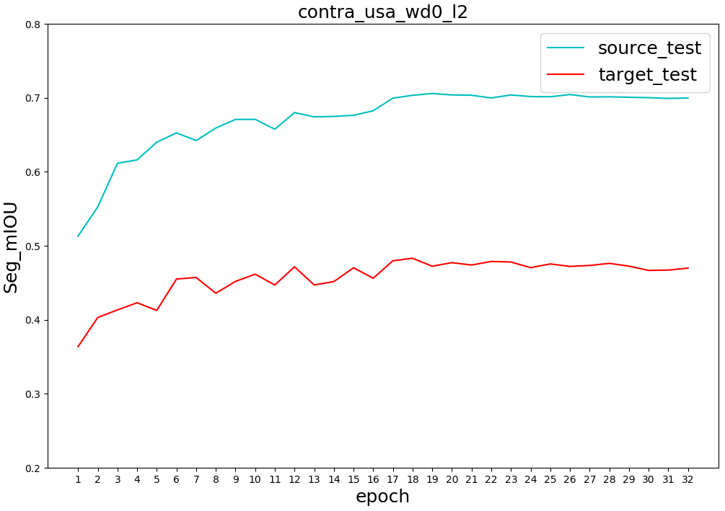
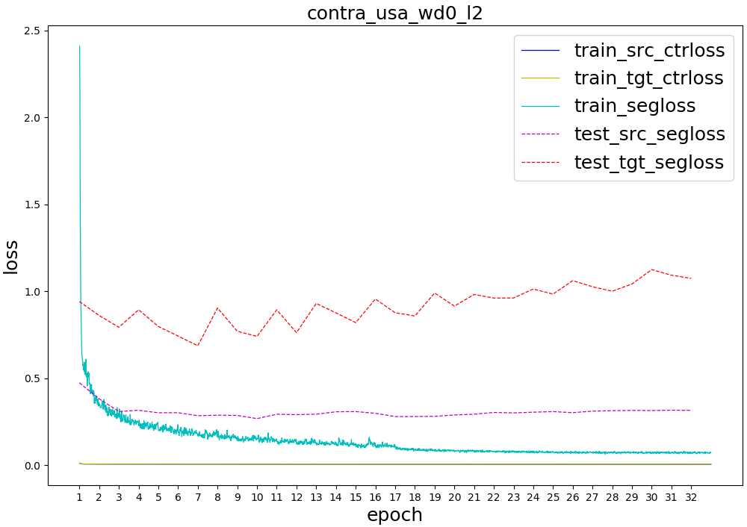
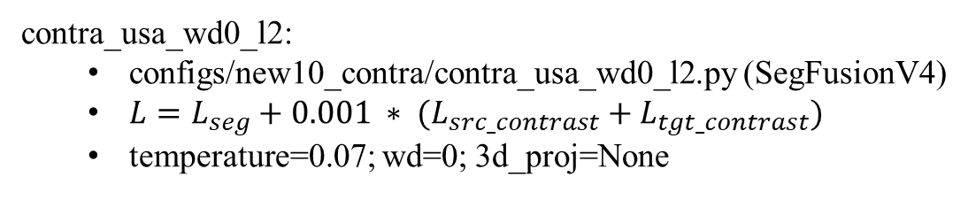
contra_usa_wd0_l2:
configs/new10_contra/contra_usa_wd0_l2.py (SegFusionV4)
$L=L_{seg}+0.001 ∗ (L_{src_contrast}+L_{tgt_contrast})$
temperature=0.07; wd=0; 3d_proj=None

Slide 19
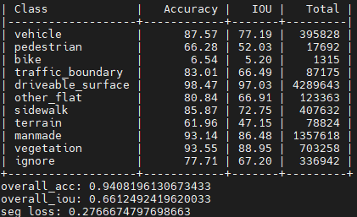
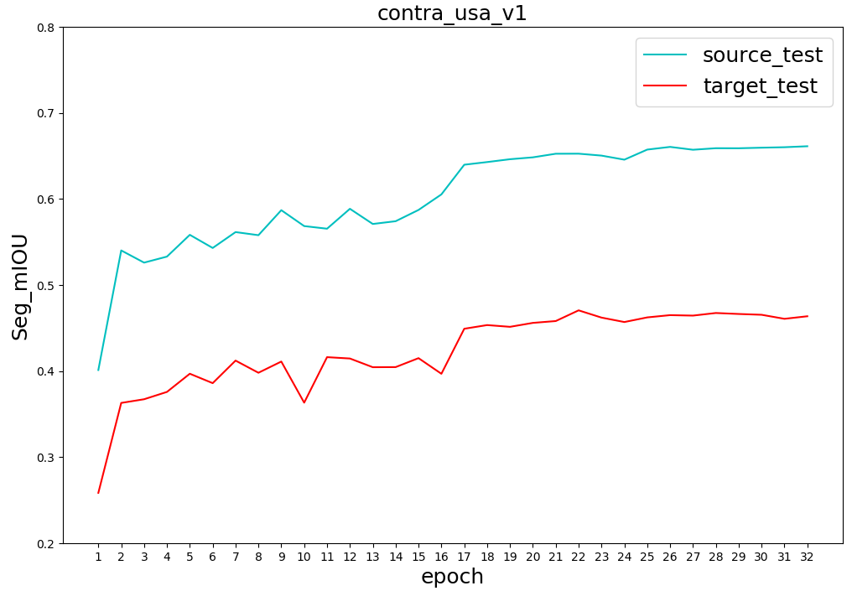
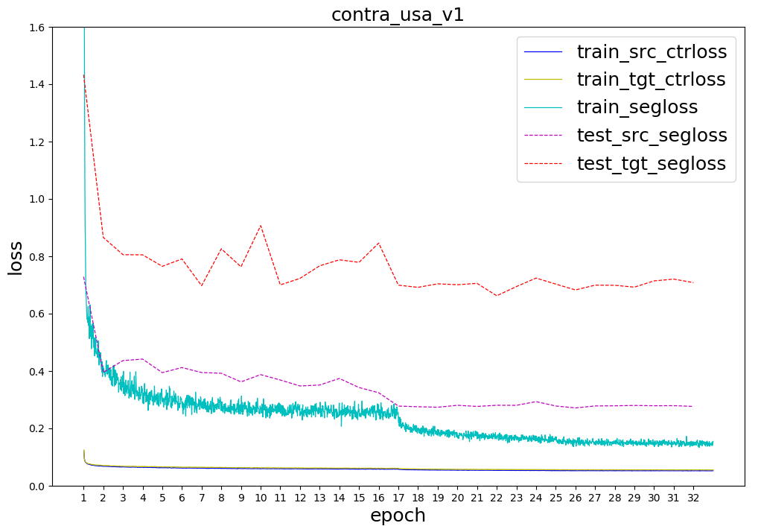
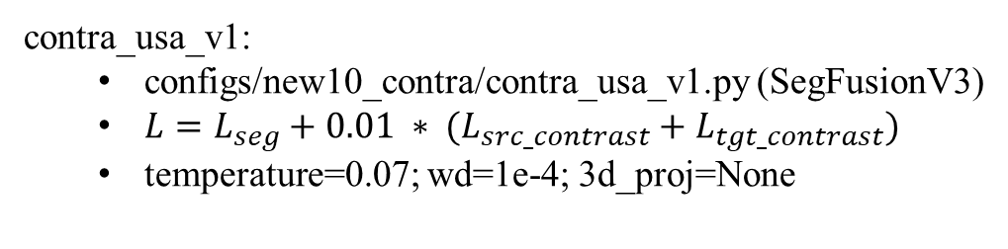
contra_usa_v1:
configs/new10_contra/contra_usa_v1.py (SegFusionV3)
$L=L_{seg}+0.01 ∗ (L_{src_contrast}+L_{tgt_contrast})$
temperature=0.07; wd=1e-4; 3d_proj=None

Slide 20
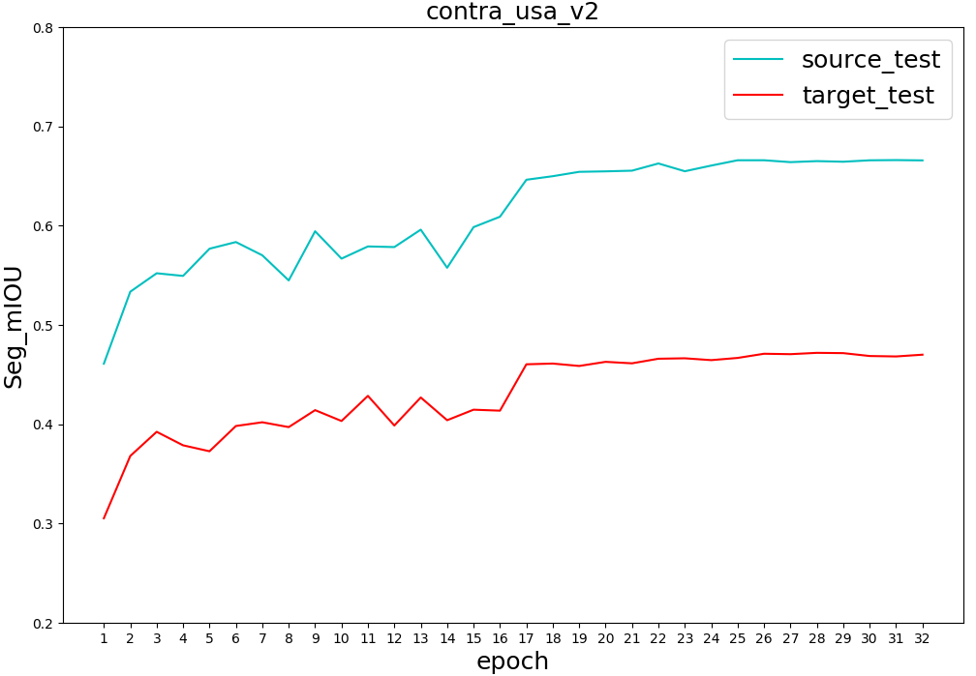
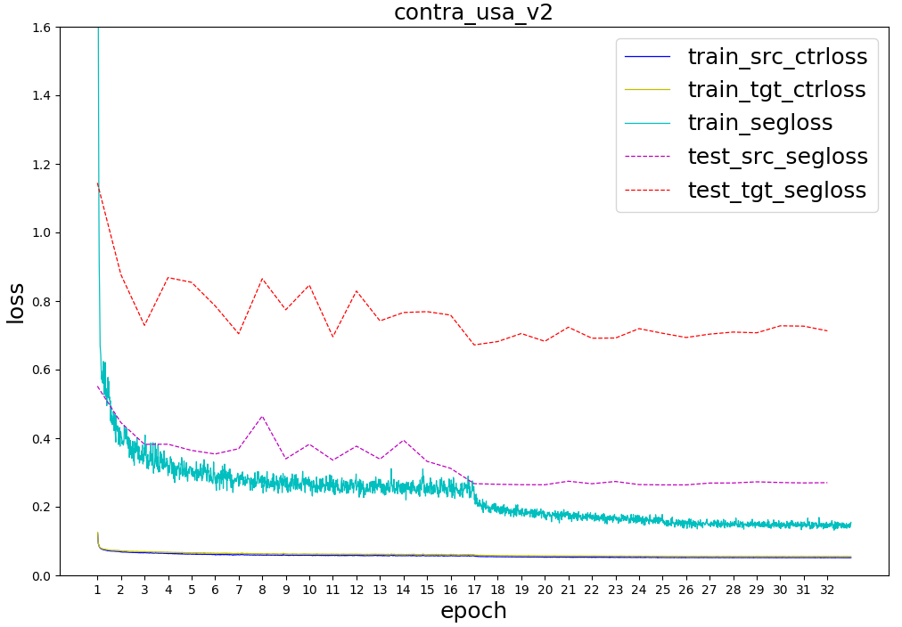
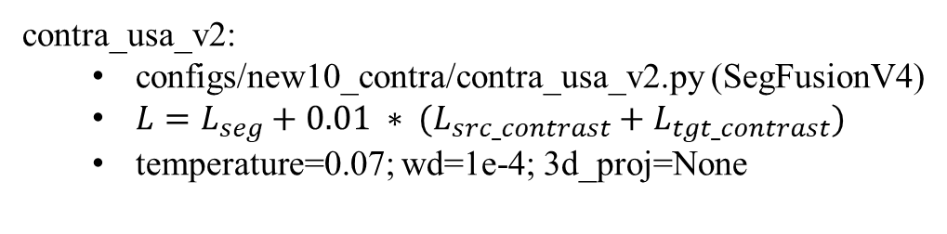
contra_usa_v2:
configs/new10_contra/contra_usa_v2.py (SegFusionV4)
$L=L_{seg}+0.01 ∗ (L_{src_contrast}+L_{tgt_contrast})$
temperature=0.07; wd=1e-4; 3d_proj=None

Slide 21
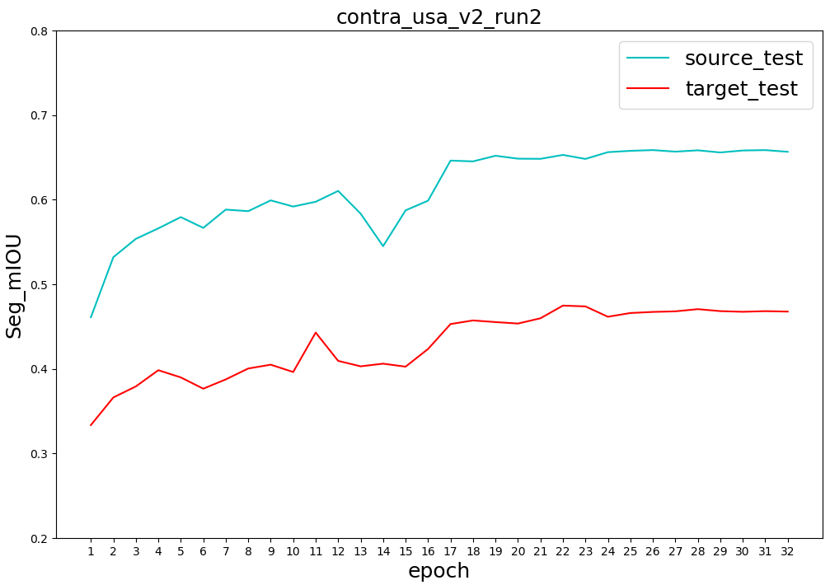
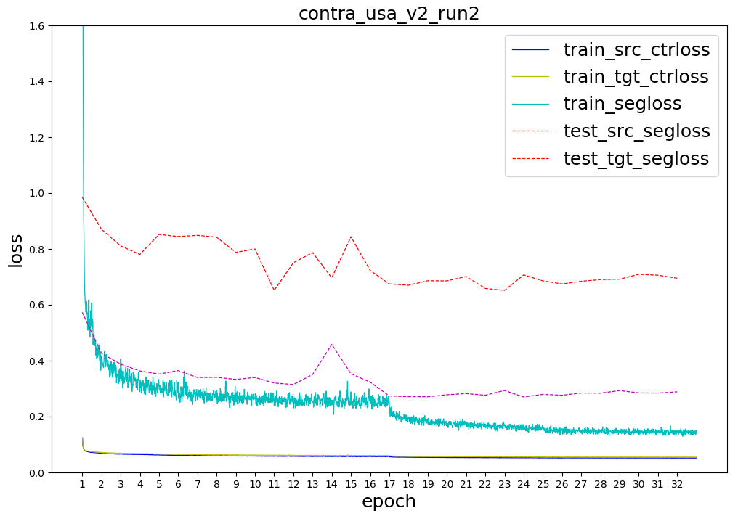
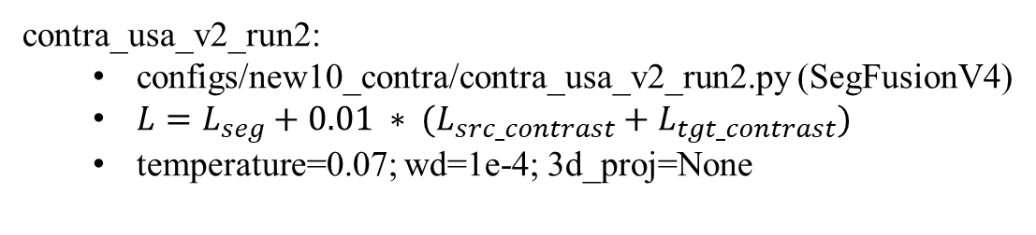
contra_usa_v2_run2:
configs/new10_contra/contra_usa_v2_run2.py (SegFusionV4)
$L=L_{seg}+0.01 ∗ (L_{src_contrast}+L_{tgt_contrast})$
temperature=0.07; wd=1e-4; 3d_proj=None

Slide 22
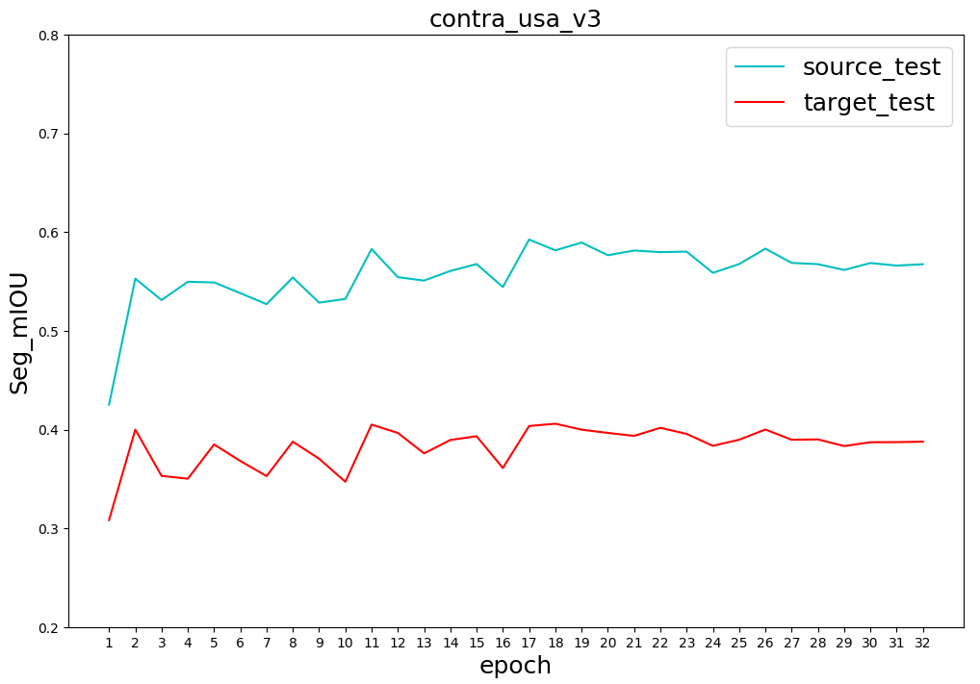
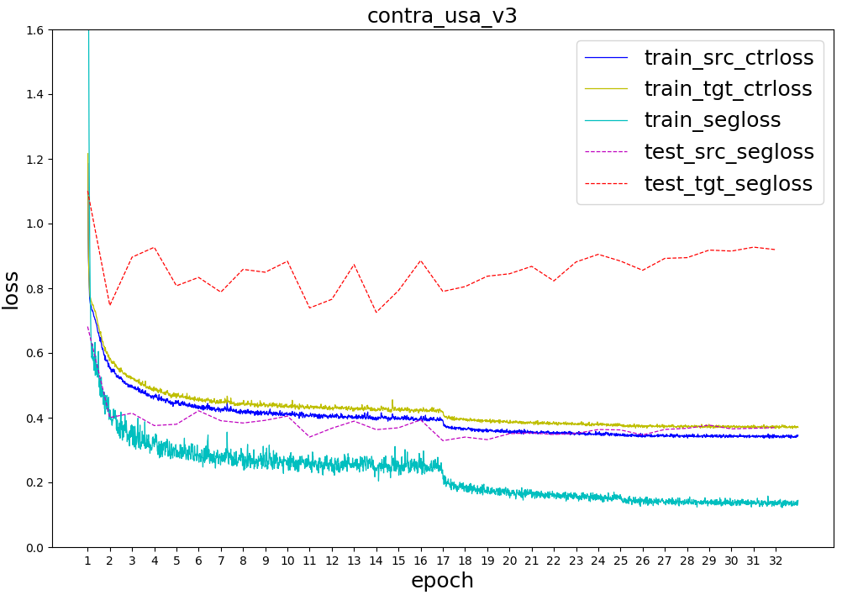
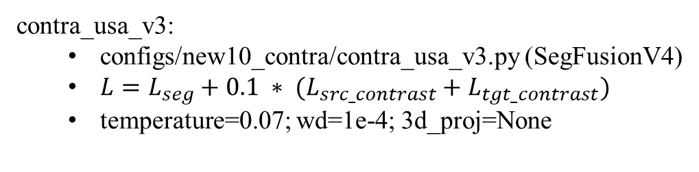
contra_usa_v3:
configs/new10_contra/contra_usa_v3.py (SegFusionV4)
$L=L_{seg}+0.1 ∗ (L_{src_contrast}+L_{tgt_contrast})$
temperature=0.07; wd=1e-4; 3d_proj=None

Slide 23
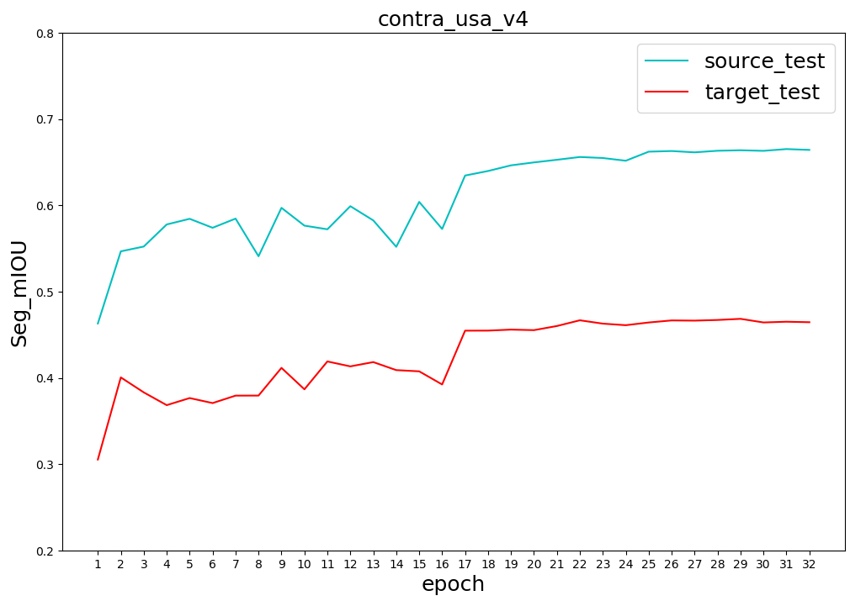

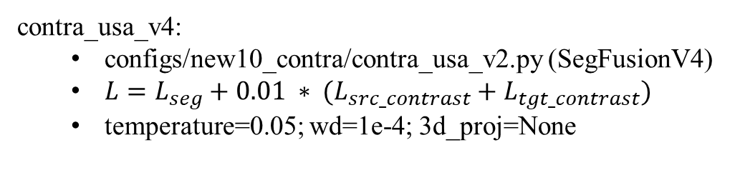
contra_usa_v4:
configs/new10_contra/contra_usa_v2.py (SegFusionV4)
$L=L_{seg}+0.01 ∗ (L_{src_contrast}+L_{tgt_contrast})$
temperature=0.05; wd=1e-4; 3d_proj=None

Slide 24
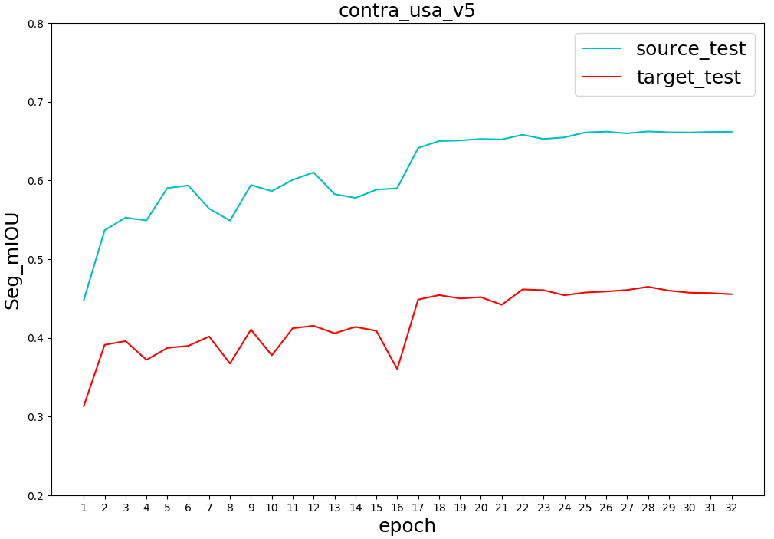
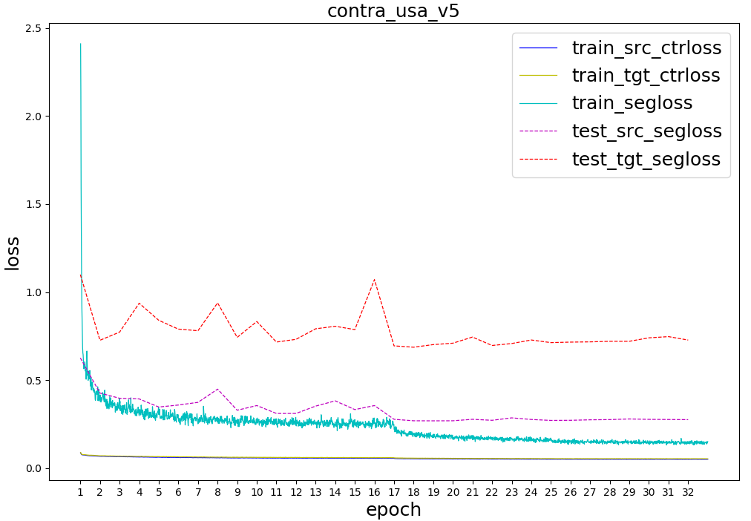
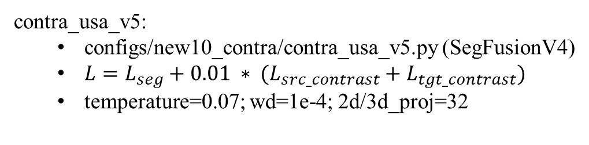
contra_usa_v5:
configs/new10_contra/contra_usa_v5.py (SegFusionV4)
$L=L_{seg}+0.01 ∗ (L_{src_contrast}+L_{tgt_contrast})$
temperature=0.07; wd=1e-4; 2d/3d_proj=32

Slide 25
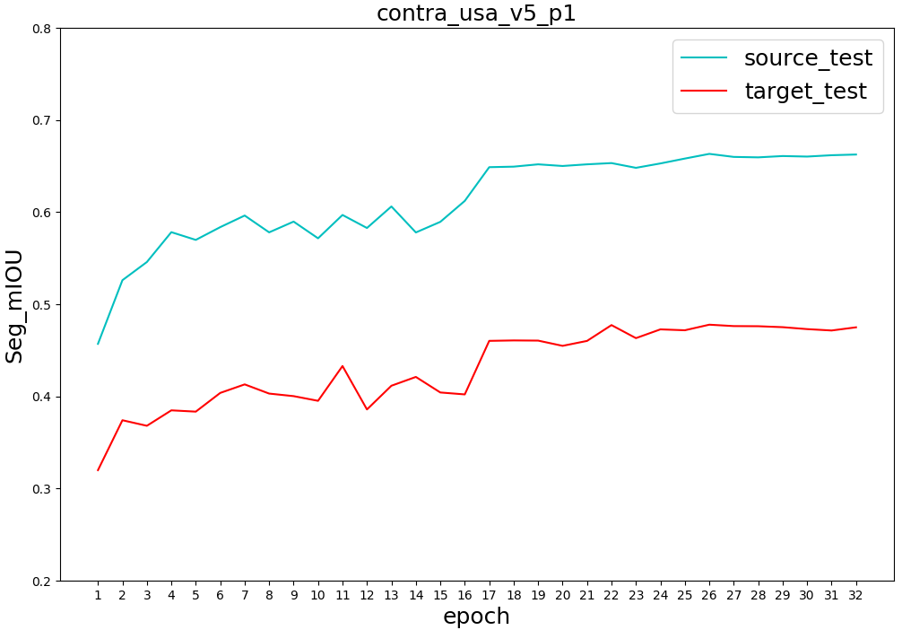
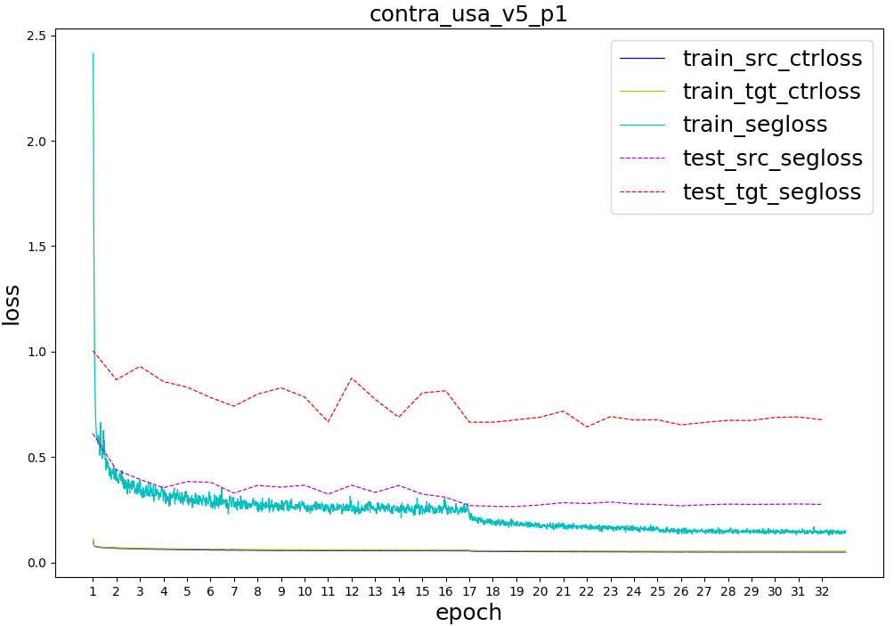
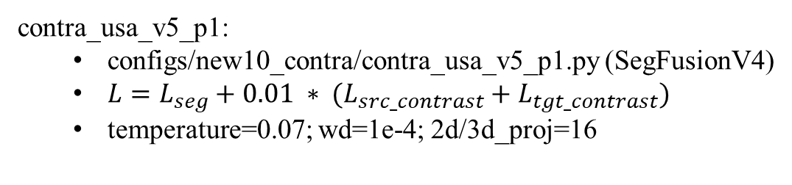
contra_usa_v5_p1:
configs/new10_contra/contra_usa_v5_p1.py (SegFusionV4)
$L=L_{seg}+0.01 ∗ (L_{src_contrast}+L_{tgt_contrast})$
temperature=0.07; wd=1e-4; 2d/3d_proj=16

Slide 26
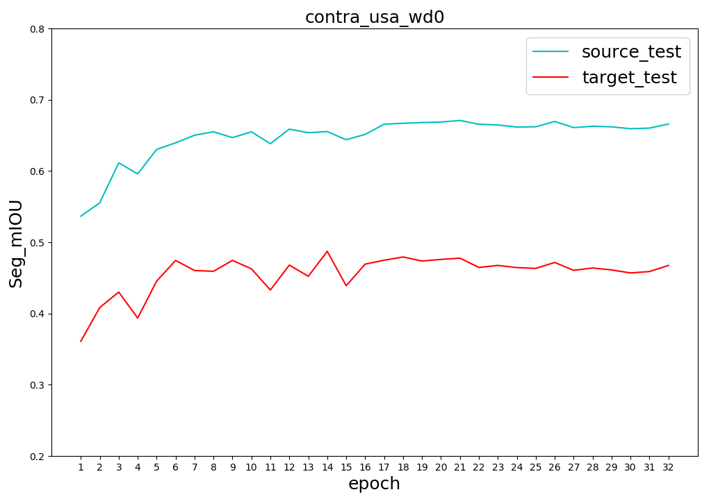
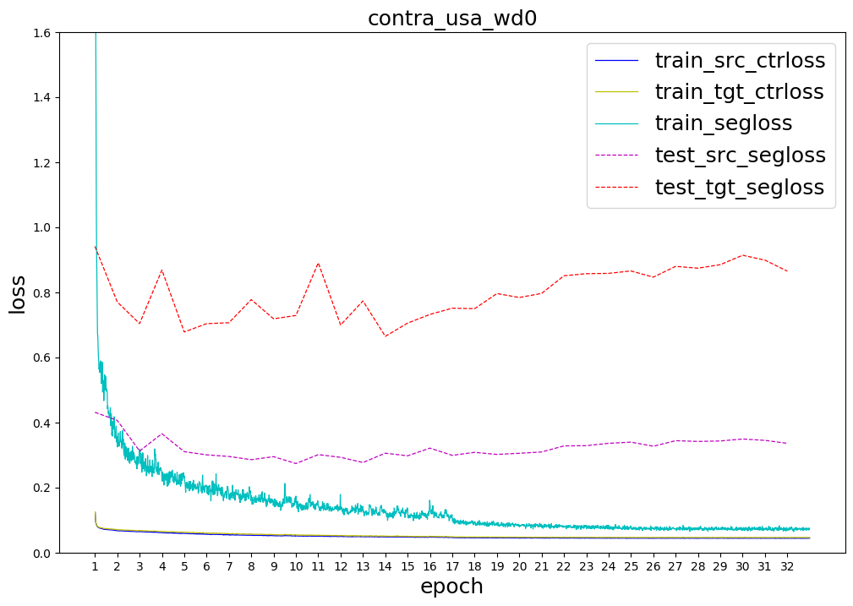
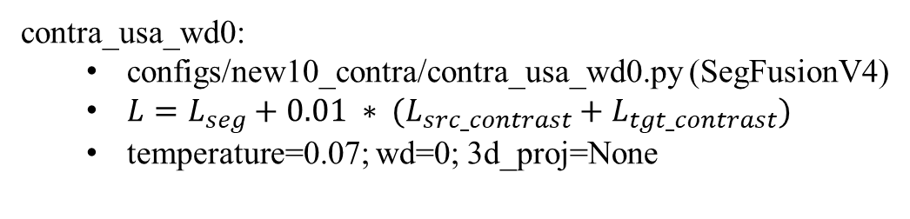
contra_usa_wd0:
configs/new10_contra/contra_usa_wd0.py (SegFusionV4)
$L=L_{seg}+0.01 ∗ (L_{src_contrast}+L_{tgt_contrast})$
temperature=0.07; wd=0; 3d_proj=None

Slide 27
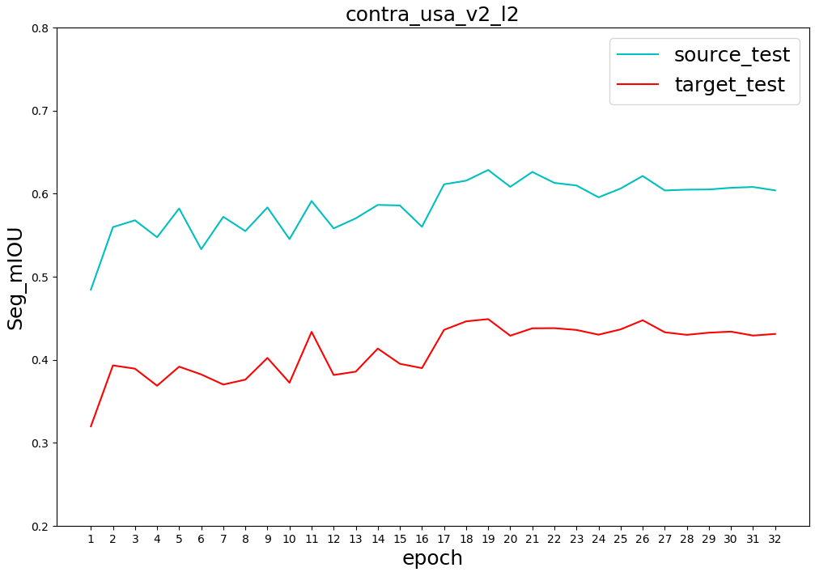
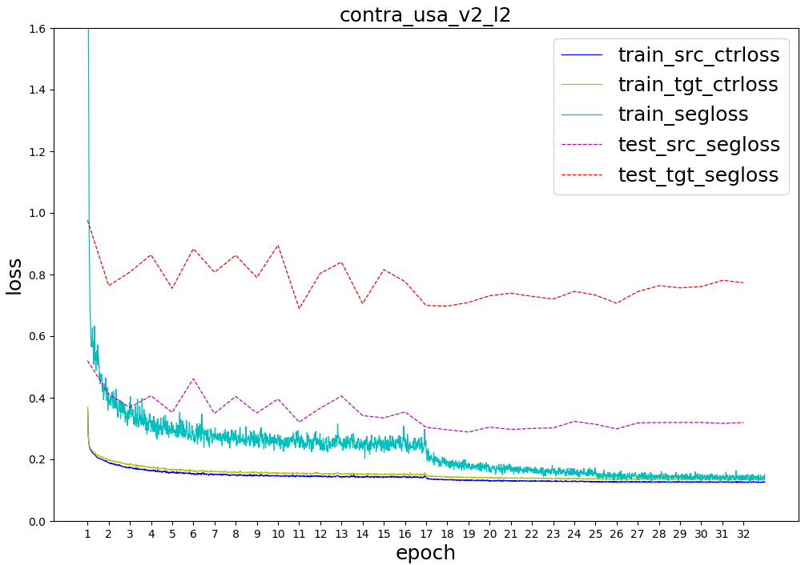
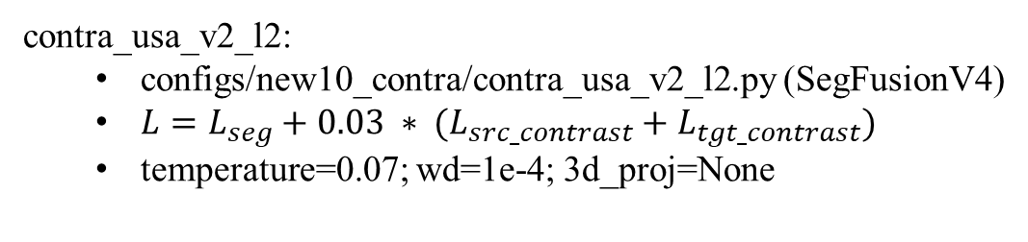
contra_usa_v2_l2:
configs/new10_contra/contra_usa_v2_l2.py (SegFusionV4)
$L=L_{seg}+0.03 ∗ (L_{src_contrast}+L_{tgt_contrast})$
temperature=0.07; wd=1e-4; 3d_proj=None

Slide 28
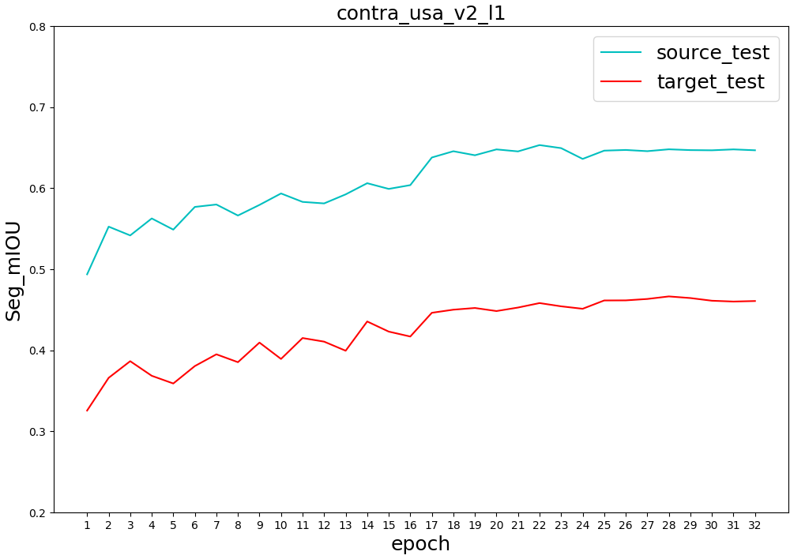


contra_usa_v2_l1:
configs/new10_contra/contra_usa_v2_l1.py (SegFusionV4)
$L=L_{seg}+0.005 ∗ (L_{src_contrast}+L_{tgt_contrast})$
temperature=0.07; wd=1e-4; 3d_proj=None

Slide 29



contra_usa_v2_l3:
configs/new10_contra/contra_usa_v2_l3.py (SegFusionV4)
$L=L_{seg}+0.005 ∗ (L_{src_contrast}+L_{tgt_contrast})$
temperature=0.07; wd=1e-4; 3d_proj=None

Slide 30



contra_usa_v2_l4:
configs/new10_contra/contra_usa_v2_l4.py (SegFusionV4)
$L=L_{seg}+0.001 ∗ (L_{src_contrast}+L_{tgt_contrast})$
temperature=0.07; wd=1e-4; 3d_proj=None

Slide 31



contra_usa_v2_t1:
configs/new10_contra/contra_usa_v2_l1.py (SegFusionV4)
$L=L_{seg}+0.01 ∗ (L_{src_contrast}+L_{tgt_contrast})$
temperature=0.03; wd=1e-4; 3d_proj=None

Slide 32



contra_usa_v2_t2:
configs/new10_contra/contra_usa_v2_22.py (SegFusionV4)
$L=L_{seg}+0.01 ∗ (L_{src_contrast}+L_{tgt_contrast})$
temperature=0.1; wd=1e-4; 3d_proj=None

Slide 33


src_usa_finetune_v2:
configs/pretrain/src_usa_finetune_v2.py
wd=1e-4
load_from=src_usa_pretrain_v2/epoch_32.pth

Slide 34


usa_finetune_v2:
configs/new10_contra/usa_finetune_v2

Slide 35


src_usa_finetune_v0:
configs/pretrain/src_usa_finetune_v0.py
wd=1e-4
load_from=src_usa_pretrain_v0/epoch_32.pth

Slide 36


src_usa_finetune_v0_w1:
configs/pretrain/src_usa_finetune_v0_w1.py
wd=0
load_from=src_usa_pretrain_v0/epoch_32.pth

Slide 37


src_usa_finetune_v1:
configs/pretrain/src_usa_finetune_v1.py
wd=0
load_from=src_usa_pretrain_v1/epoch_32.pth

Slide 38



Slide 39



baseline_usa_wd0_run2:
configs/new10_contra/vanilla_fusion/baseline_usa_wd0_run2.py
train loss: $L=L_{seg}$
wd=0

Slide 40



baseline_usa_v2:
configs/new10_contra/vanilla_fusion/baseline_usa_v2.py (SegFusionV3)
train loss: $L=L_{seg}$
weight_decay=1e-4

Slide 41



baseline_usa_v3:
configs/new10_contra/vanilla_fusion/baseline_usa_v3.py (SegFusionV4)
train loss: $L=L_{seg}$
weight_decay=1e-4

Slide 42



baseline_usa_v3_run2:
configs/new10_contra/vanilla_fusion/baseline_usa_v3_run2.py (SegFusionV4)
train loss: $L=L_{seg}$
weight_decay=1e-4

Slide 43



baseline_usa_wd0:
configs/new10_contra/vanilla_fusion/baseline_usa_wd0.py
train loss: $L=L_{seg}$
weight_decay=0

Slide 44


single_2d_usa_v0:
configs/new10_contra/vanilla_fusion/single_2d_usa_v0.py
weight_decay=1e-4

Slide 45


single_2d_usa_v1:
configs/new10_contra/vanilla_fusion/single_2d_usa_v1.py
weight_decay=0

Slide 46


single_2d_usa_v2:
configs/new10_contra/vanilla_fusion/single_2d_usa_v2.py
weight_decay=1e-2

Slide 47


single_3d_usa_scn0:
configs/new10_contra/vanilla_fusion/single_3d_usa_scn0.py
weight_decay=1e-4

Slide 48


single_3d_usa_scn1:
configs/new10_contra/vanilla_fusion/single_3d_usa_scn1.py
weight_decay=0
Single Input

Slide 49


single_3d_usa_scn2:
configs/new10_contra/vanilla_fusion/single_3d_usa_scn2.py
weight_decay=0

Slide 50
new class set(11 classes)
Single Sample Input for 3D Network
SegFusionV3

Slide 51



new class set(11 classes)
pretrain:
configs/new10_contra/contra_usa_pretrain_v0/v1.py
pre-train loss: $L=λ∗(L_{src_contrast}+L_{tgt_contrast})$

Slide 52



new class set(11 classes)
usa_fintune_v0:
configs/new10_contra/usa_fintune_v0.py
fine-tune loss: $L=L_{seg}$

Slide 53



new class set(11 classes)
usa_fintune_v0_w1:
configs/new10_contra/usa_fintune_v0_w1.py
fine-tune loss: $L=L_{seg}$

Slide 54



new class set(11 classes)
usa_fintune_v0_w2:
configs/new10_contra/usa_fintune_v0_w2.py
fine-tune loss: $L=L_{seg}$

Slide 55



new class set(11 classes)
usa_fintune_v1:
configs/new10_contra/usa_fintune_v1.py
fine-tune loss: $L=L_{seg}$

Slide 56



new class set(11 classes)
contra_usa_v0:
configs/new10_contra/contra_usa_v0.py
$L=L_{seg}+0.01 ∗ (L_{src_contrast}+L_{tgt_contrast})$

Slide 57


new class set(11 classes)
usa_fintune_freeze_v0:
configs/new10_contra/usa_fintune_freeze_v0.py
freeze backbone when fine-tune; only train fc head

Slide 58




new class set(11 classes)
baseline_usa_v0:
configs/new10_contra/vanilla_fusion/baseline_usa_v0.py
train loss: $L=L_{seg}$

Slide 59



new class set(11 classes)
baseline_usa_v1:
configs/new10_contra/vanilla_fusion/baseline_usa_v1.py
train loss: $L=L_{seg}$

Slide 61



xMuda class set(5 classes)
usa_fintune_v0_w0:
configs/fusion_consis/pretrain/usa_fintune_v0_w0.py
fine-tune loss: $L=L_{seg}$

Slide 62



xMuda class set(5 classes)
usa_fintune_v0:
configs/fusion_consis/pretrain/usa_fintune_v0.py
fine-tune loss: $L=L_{seg}$

Slide 63


xMuda class set(5 classes)
usa_fintune_freeze_v0:
configs/fusion_consis/pretrain/usa_fintune_freeze_v0.py
freeze backbone when fine-tune; only train fc head

Slide 64




xMuda class set(5 classes)
baseline:
configs/fusion_consis/xmuda/baseline2_usa.py
train loss: $L=L_{seg}$

